Slide 1
Agenda
Building Microservices with .NET
Evolution of Computing
Introduction to Microservices
Microservices Principles
Advantages of Microservices
Challenges of Microservices
N-Layer App to Microservices
Microservices Patterns
Hands-On

Slide 2




About Mentor
Founder & CEO at ScholarHat
Speaker and Technical Consultant
9th Times Microsoft MVP (2016-2024)
Corporate Trainer for IBM, Cognizant, Dell, TCS etc.
Microsoft Certified Azure Professional
Trained 1Lakh+ Students Across the World
Author of 15 eBooks on Interview Q&A
Author of 500+ Articles
Mentor of 30+ Video Based Courses

Slide 3
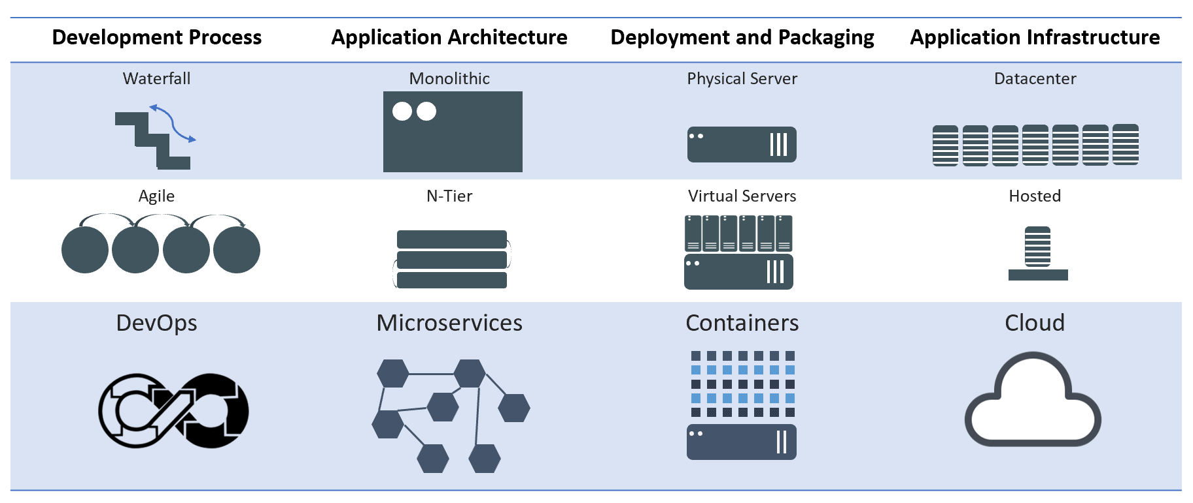
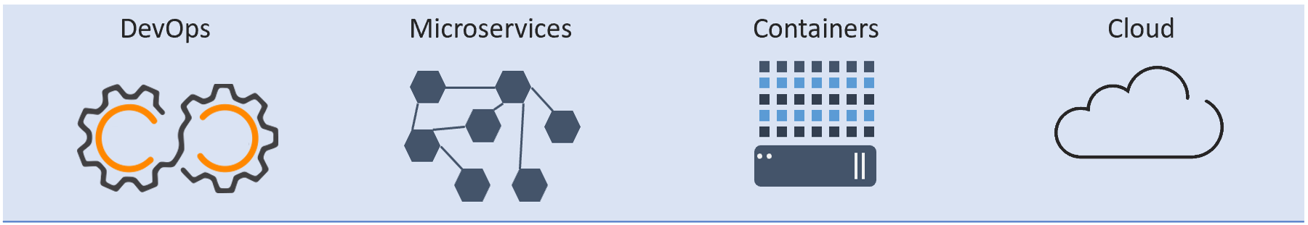
Evolution of Computing
Notes:
Now, let's look at how a virtual machine (VM) is different from a container.
While containers may sound like a VM, the two are distinct technologies. With VMs each virtual machine includes the application, the necessary binaries and libraries and the entire guest operating system.
Whereas, Containers include the application, all of its dependencies, but share the kernel with other containers and are not tied to any specific infrastructure, other than having the Docker engine installed on its host – allowing containers to run on almost any computer, infrastructure and cloud.
Note - at this time, Windows and Linux containers require that they run on their respective kernel base, therefore, Windows containers cannot run on Linux hosts and vice versa.

Slide 4
Introduction to Microservices
A Microservice is a small unit that has only one responsibility or single logic which solve a specific problem.
Microservices are small & independent services that work together to build highly automated, independent and evolving software.
Each Microservice can be deployed independently.
All services don't need to share the same technology stack, libraries, or frameworks.
Notes:
Service Oriented – Services communicate with each other over the network
Loosely coupled elements – You can update the service independently and updating one service doesn’t require changing in any other service
Bounded Context – Self Contained; you can update the code without knowing anything about the internals of other microservices

Slide 5
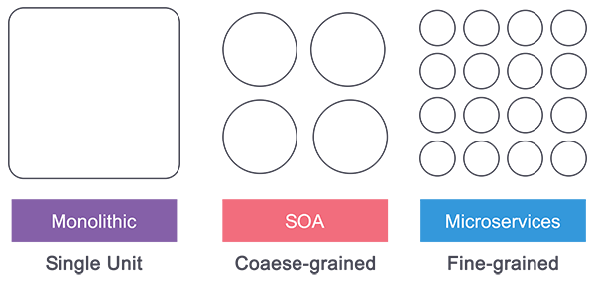
Monolithic vs. N-Layer vs. SOA vs. Microservices
Monolithic: Single Unit
Multi Units: N-Layer/SOA
Smaller Units: Microservices
Notes:
The main point to SOA (as compared to standard N-Tier architecture) is re-usability of the underlying services. This is where the aforementioned loose coupling comes in very handy - your web services are generic enough and independent enough to be used in many different applications.

Slide 6
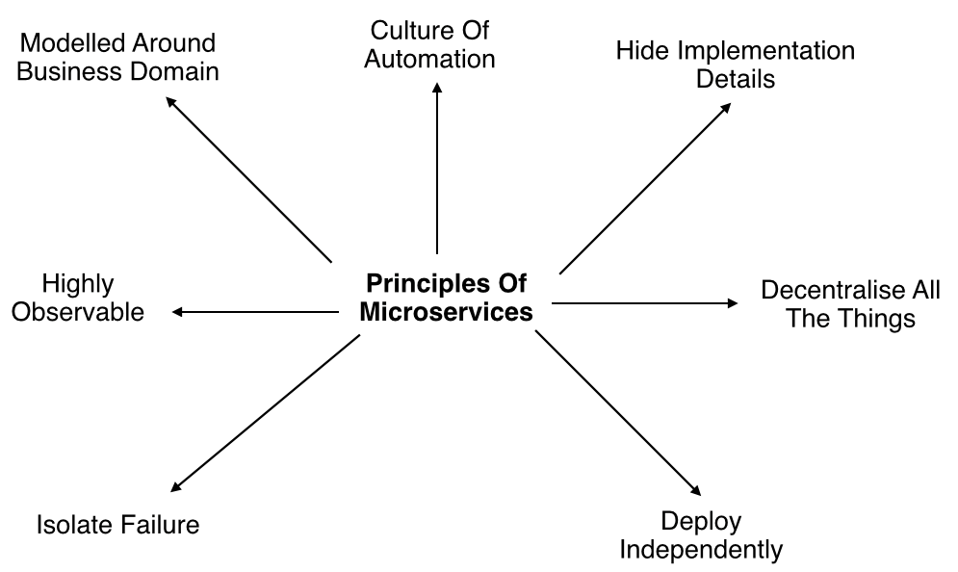
Microservices Principles

Slide 7
Microservices Principles Contd..
Modelled around business domain : Separate system capability into different domains and each domain will focus on one thing and its associated logic.
Culture of Automation : Follow the culture of automation by designing it for continues integration and continuous delivery.
Hide implementation details : Hiding the internal details reduce the coupling and helps to do changes and improvement without affecting the overall architecture.
Decentralization : There is no centralized database, usually each service is designed to manage its own database.

Slide 8
Microservices Principles Contd..
Deploy Independently : Each service can be deployed independently.
Failure Isolation : The impact of a failure is less in microservice architecture compares to monolithic type as it will only affect that particular service and its associates. Other services can keep running.
Highly Observable : The services should collect as much information to analyze what is happening within each of them like log events and stats.

Slide 9
When to use Microservices Architecture
Large applications that require a high release velocity.
Complex applications that need to be highly scalable.
Applications with rich domains or many subdomains.
An organization that consists of small development teams.

Slide 10
Advantages of Microservices
Language independent and framework independent.
Support Independent development, deployment, and versioning.
Even you can scale them in seconds without compromising the integrity of an application.
Better fault isolation keeps other services to work even on failure.
Zero downtime upgrades.
Services can be from different servers or different datacenters.
Supports CI/CD.
Notes:
Self-healing refers to the process of recovery (generally from psychological disturbances, trauma, etc.), motivated by and directed by the patient, guided often only by instinct. Such a process encounters mixed fortunes due to its amateur nature, although self-motivation is a major asset.

Slide 11
Challenges of Microservices
Complexity - A microservices application is more complex as compared to the equivalent monolithic application.
Development and testing - Building and testing a service that relies on other services need domain understanding and refactoring them can be difficult.
Lack of governance - The decentralized approach to building microservices has advantages, but it also leads to so many problems like maintenance because of many different languages and frameworks.
Network congestion and latency - The use of many small, services can result in additional latency because of interservice communication and a long chain of service dependencies. So design APIs carefully and use asynchronous communication patterns.

Slide 12
Challenges of Microservices Contd..
Data Integrity - Each microservice is responsible for its own data persistence. As a result, data consistency can be a challenge.
Management - To be successful with microservices requires a mature DevOps culture. Correlated logging across services can be challenging for a single user operation.
Versioning - Be careful while updating a service. It must not break services that depend on it. So without careful design, you might have problems with backward or forward compatibility.
Skillset - Microservices are highly distributed systems. So need a skilled and experience team to implement it.

Slide 13
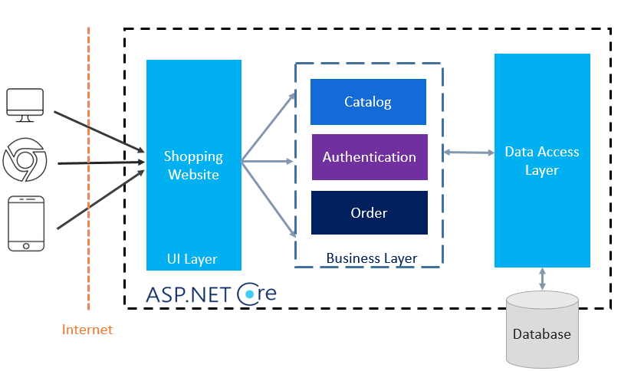
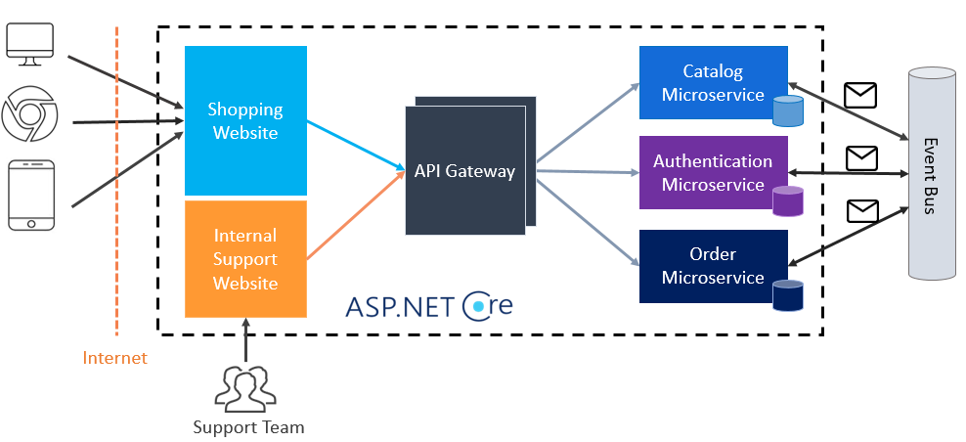
N-Layer App to Microservices

Slide 14
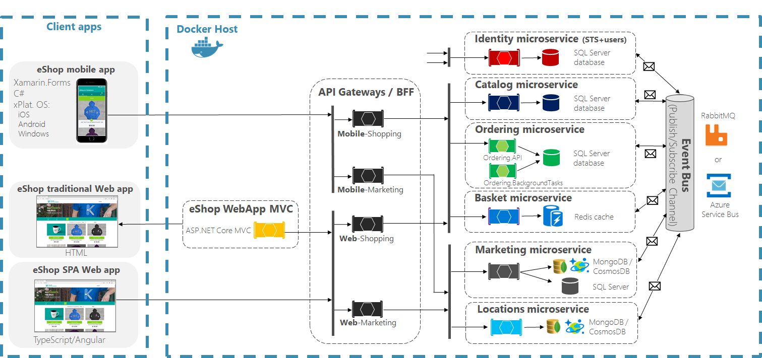
eShop Application Architecture: Docker
Reference: https://github.com/dotnet-architecture/eShopOnContainers/tree/master

Slide 15
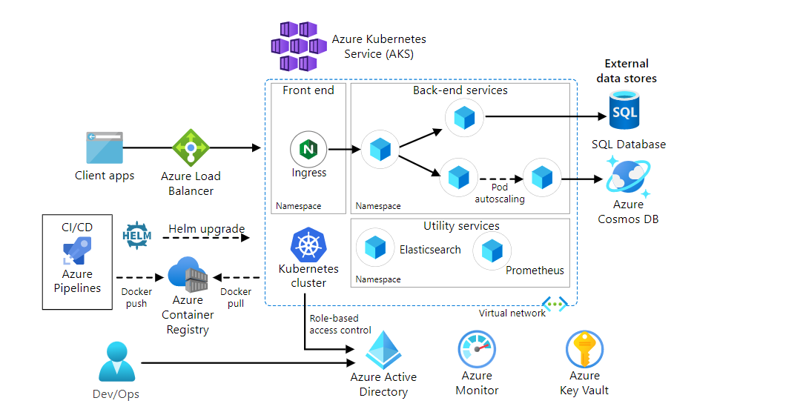
Microservices CI/CD

Slide 16
Greenfield vs. Brownfield
Greenfield Development happens when you start a brand new project with clean slate development. No legacy code or no old development to maintain. Starting project from scratch with no restrictions on what you’re doing (other than business rules).
Brownfield Development happens when business decide to develop/improve upon an existing application infrastructure. As an upgrade is implemented into an existing solution.

Slide 17
Microservices Patterns
Decomposition Patterns
  Decompose by Business Capability
  Decompose by Subdomain
  Strangler Pattern
Integration Patterns
  API Gateway Pattern
  Aggregator Pattern
  Client-Side UI Composition Pattern
Database Patterns
  Database per Service
  Shared Database
  CQRS Pattern
  Saga Pattern
Communication Patterns
  Request/Response Pattern
  Messaging Pattern
  Event Driven Pattern
Cross-Cutting Concern Patterns
  Externalized Configuration
  Service Discovery Pattern
  Circuit Breaker Pattern
Observability Patterns
  Log Aggregation
  Performance Metrics
  Distributed Tracing
  Health Check
Deployment Patterns
  Multiple Service Instances per Host
  Service Instance per Host
  Serverless Deployment
  Service Deployment Platform
Notes:
https://medium.com/@madhukaudantha/microservice-architecture-and-design-patterns-for-microservices-e0e5013fd58a
https://dzone.com/articles/design-patterns-for-microservices
https://docs.microsoft.com/en-us/dotnet/architecture/microservices/microservice-ddd-cqrs-patterns/microservice-domain-model

